Slide 1
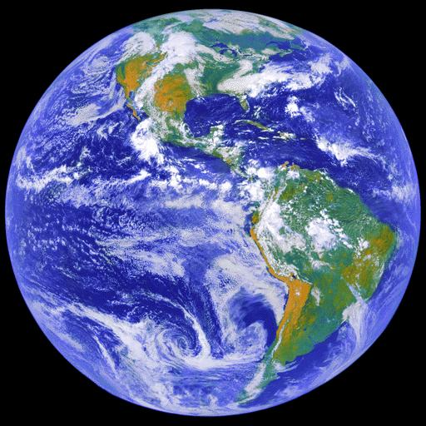

INTRO TO NATURE & SOCIETY:
Unit 1 The “spheres” of Earth
Hydrosphere
Lithosphere
Atmosphere
Biosphere

Slide 2
Lines of latitude to know*:
Equator (O°) starting point to number parallels
Tropic of Cancer (23.5° N)
Tropic of Capricorn (23.5° S)
Arctic Circle (66.5° N)
Antarctic Circle (66.5° S)
45° N (our latitude)
*we will explain their significance later

Slide 4
Sustainability Science:
studies the relationships among
  natural systems,
  societies,
  political economy
  and the interdependence of all of these over space and time
-with the purpose of assessing how local, regional and global societies can live with equity and inclusion without endangering future societies from being able to do the same.

Slide 5
Sustainability Science
  methods, not just a body of knowledge
  holistic
  eclectic

Slide 6
Earth Systems Concepts
System: an ordered, interrelated set of things & their attributes, linked by flows of energy & matter, that is distinct from the surrounding environment
Open systems have inputs and outputs of energy and matter
System feedback: when outputs influence continuing system outputs via feedback loops. Example of ice-albedo feedback:
System equilibrium: when rates of inputs and outputs are equal and amounts of energy and matter in storage are fairly constant

Slide 7
Geographic Information Systems (GIS)
GIS is defined as any system which facilitates the analysis of multiple layers of spatial data (maps of specific themes)

Slide 8
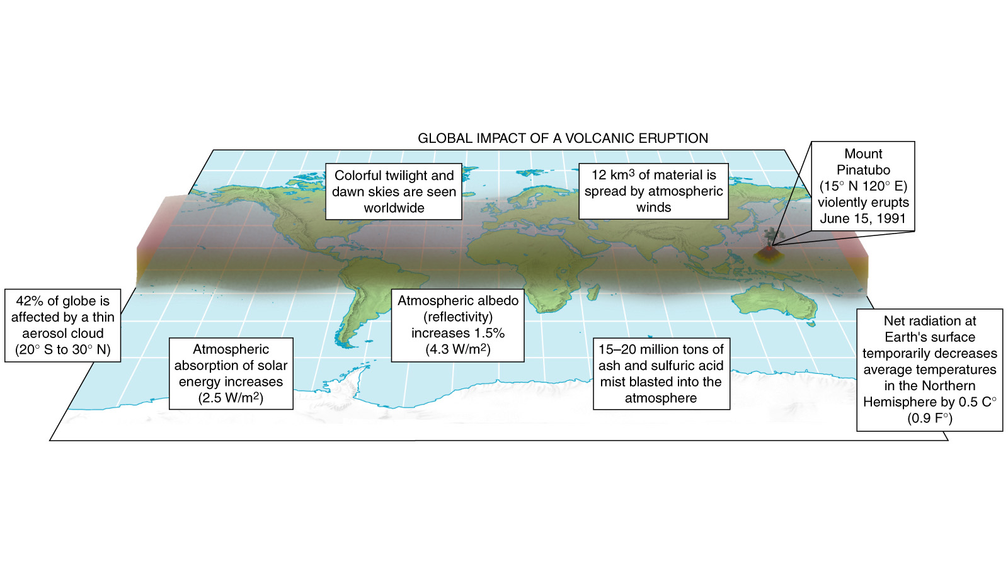
Global Effects of
Mount Pinatubo
Figure 1.5

Slide 9
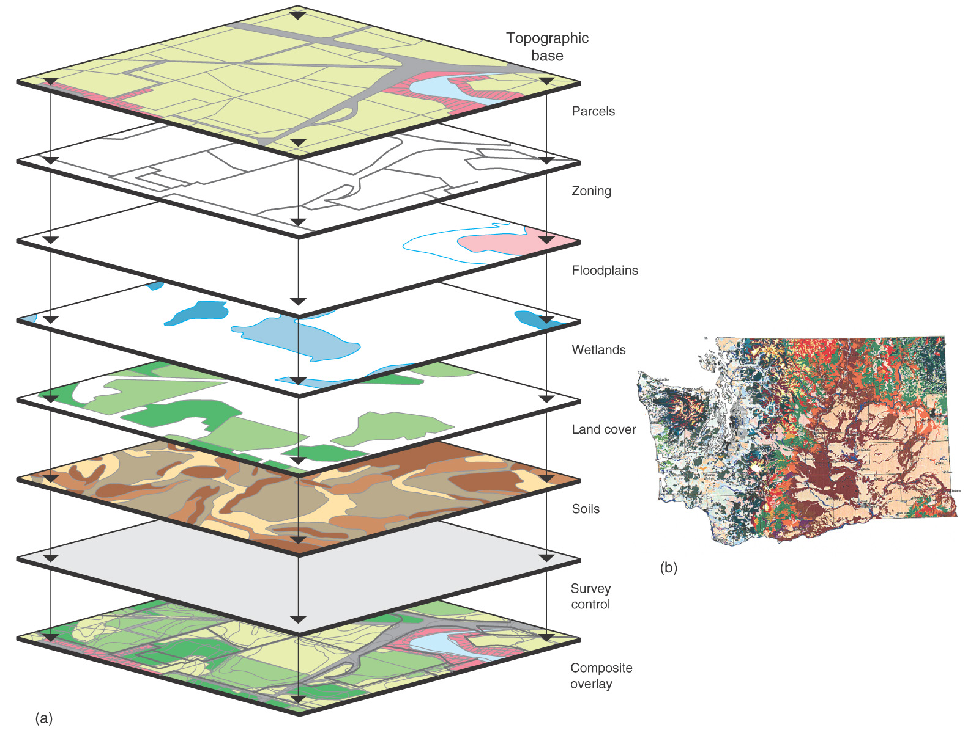
GIS System
Figure 1.23

Slide 10
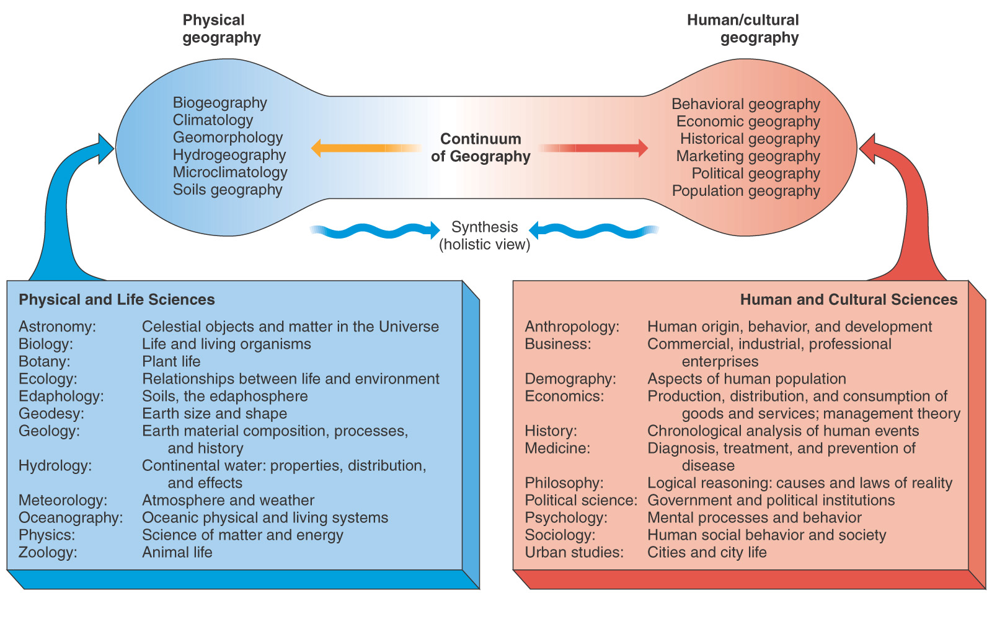
Figure 1.2

Slide 11
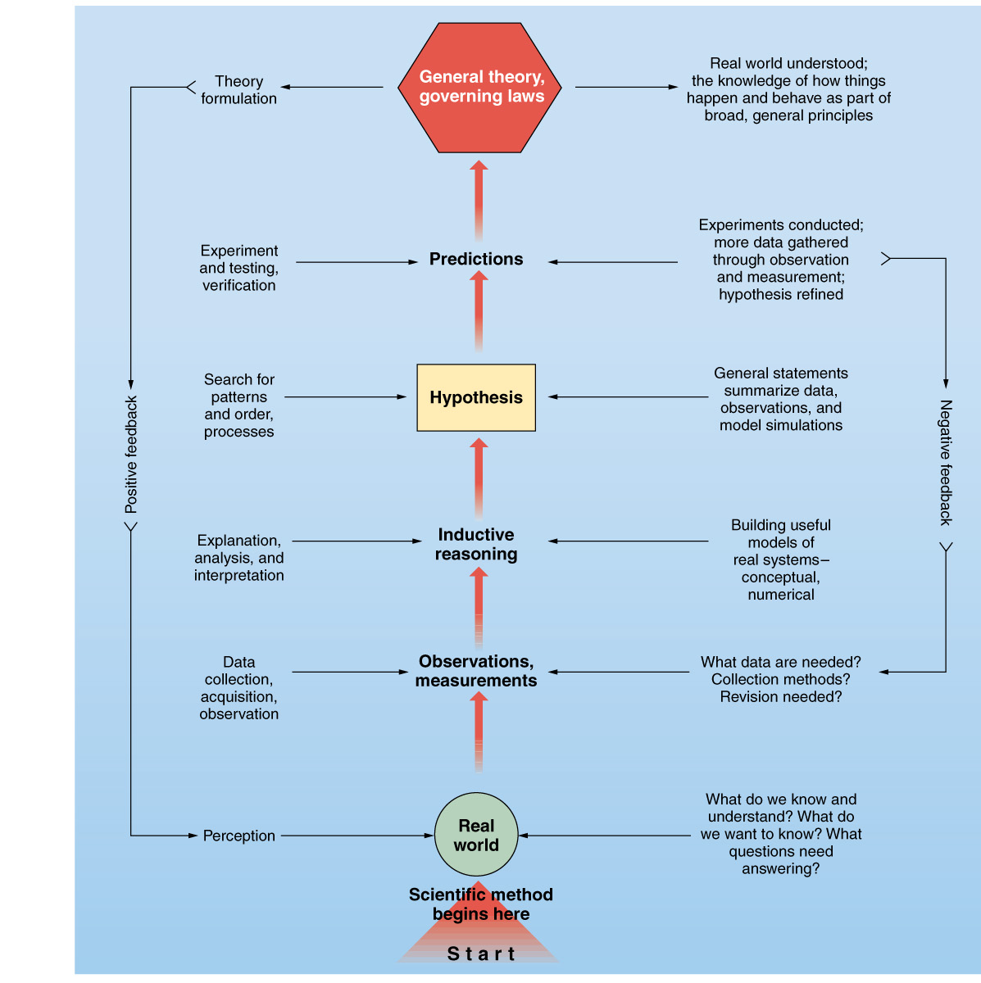
Physical geographers use scientific methods:
prediction
explanation
observation
Example of carbon dioxide’s ability to trap heat in the atmosphere: read part 1 of this link- https://www.co2.earth/1820-1930-fourier-to-arrhenius
Listen to the audio embedded below after you look at the link material above.
Figure 1

Slide 12
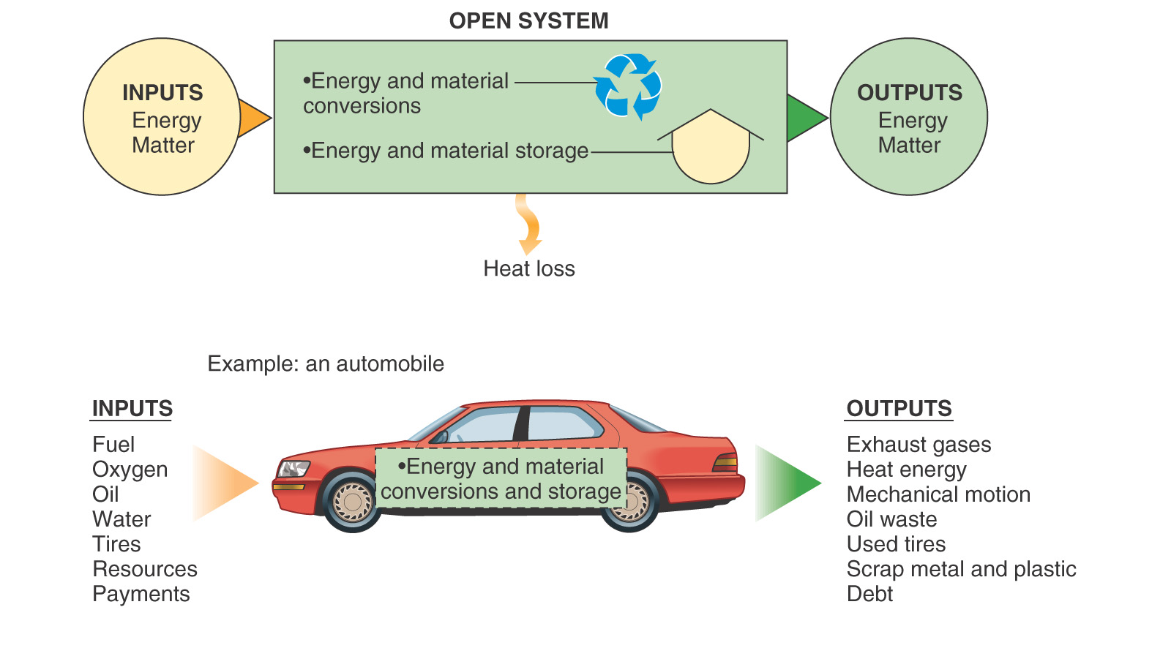
Figure 1.3

